Slide 1


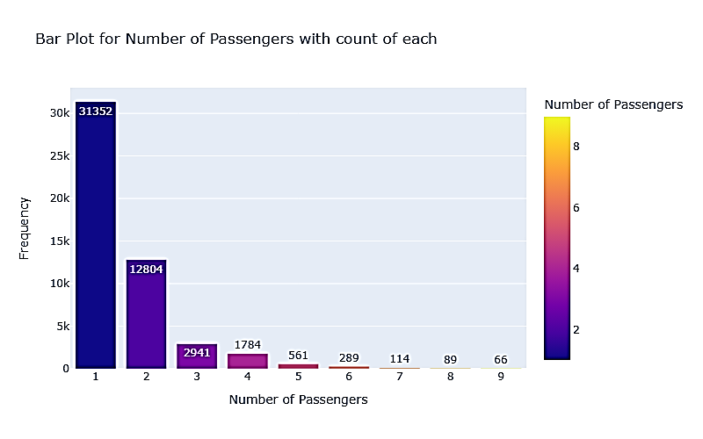
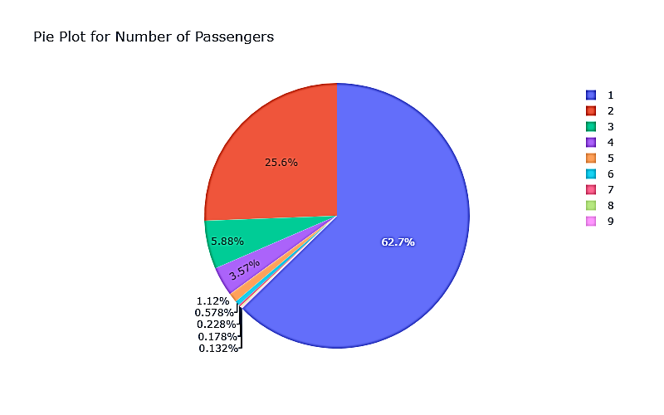
Forage British Airways Data Science Job Sim Task 2 - Predicting customer buying behaviour
Analysis: -

Slide 2
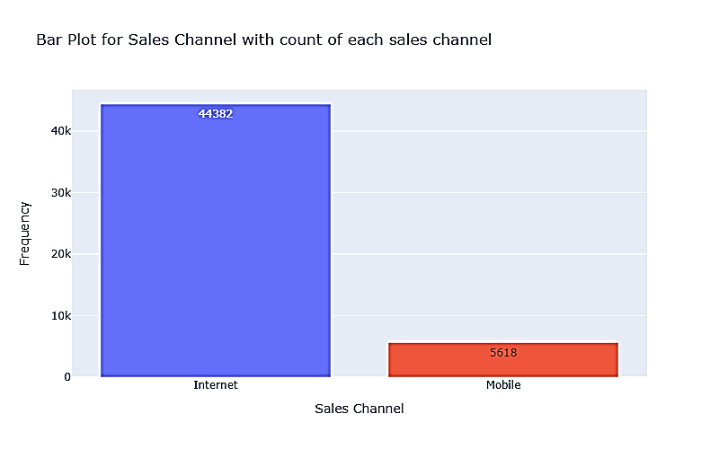
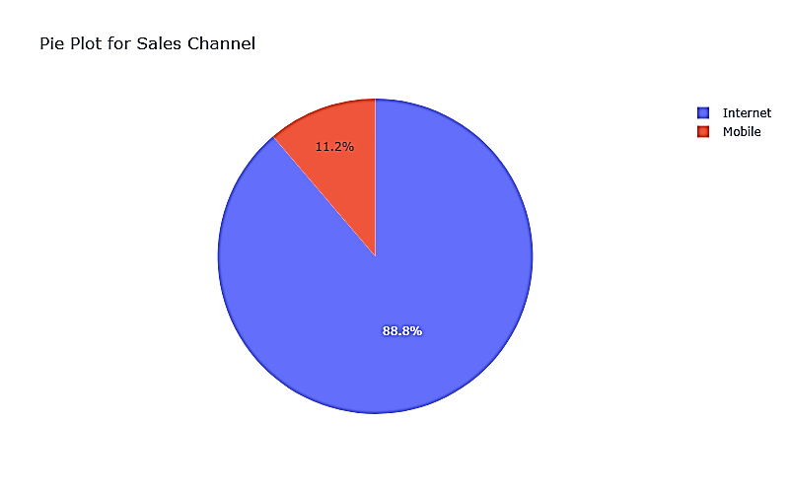
Forage British Airways Data Science Job Sim Task 2 - Predicting customer buying behaviour
Analysis: -

Slide 3
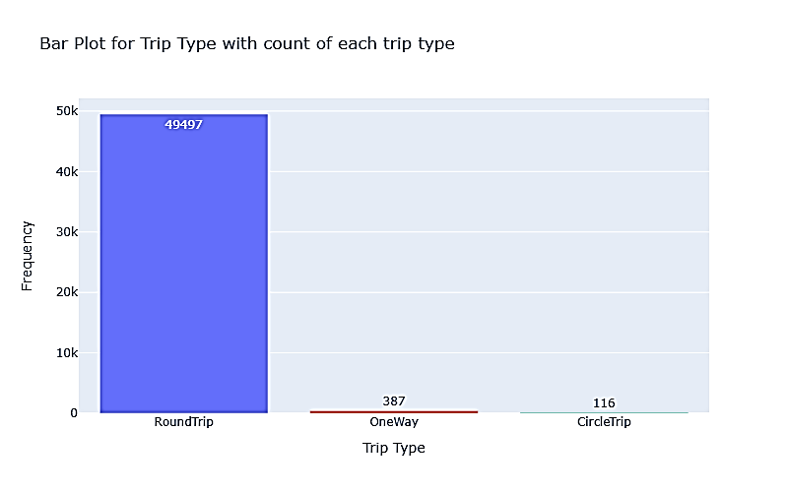
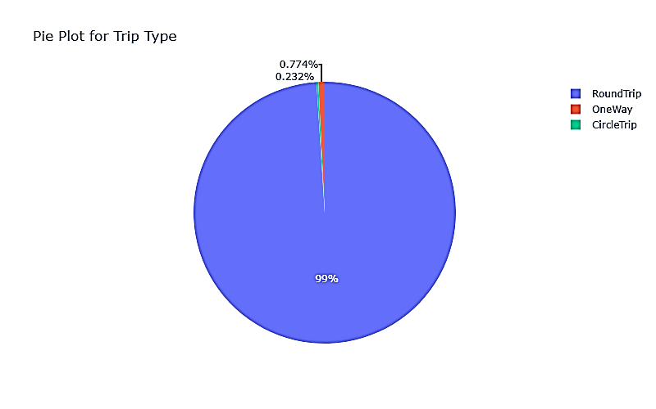
Forage British Airways Data Science Job Sim Task 2 - Predicting customer buying behaviour
Analysis: -

Slide 4
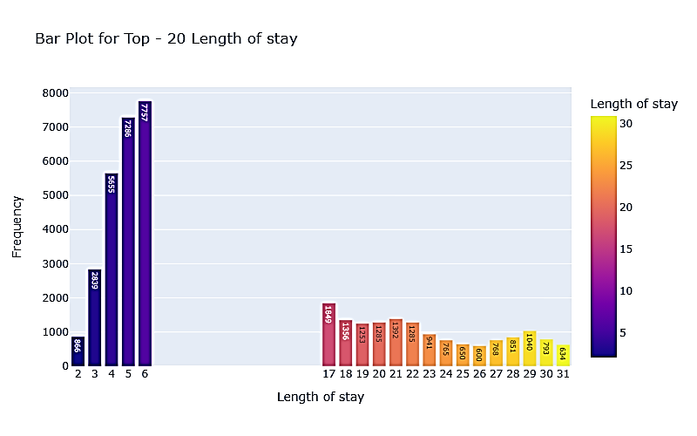
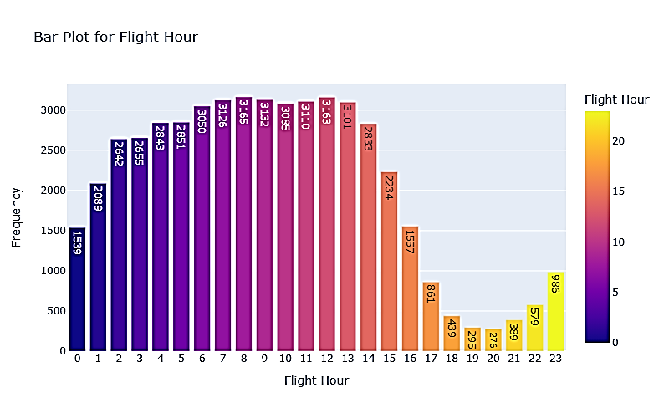
Forage British Airways Data Science Job Sim Task 2 - Predicting customer buying behaviour
Analysis: -

Slide 5
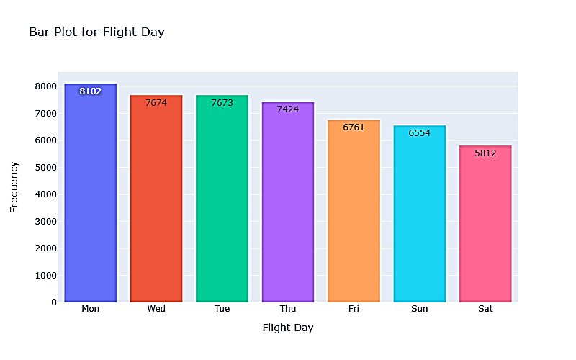
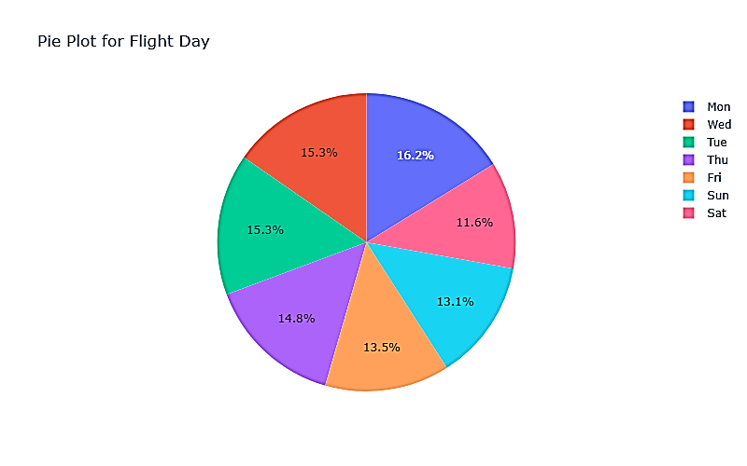
Forage British Airways Data Science Job Sim Task 2 - Predicting customer buying behaviour
Analysis: -

Slide 6
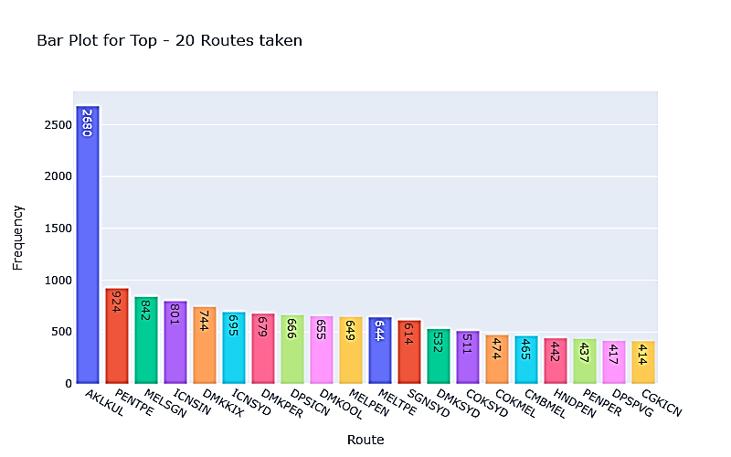
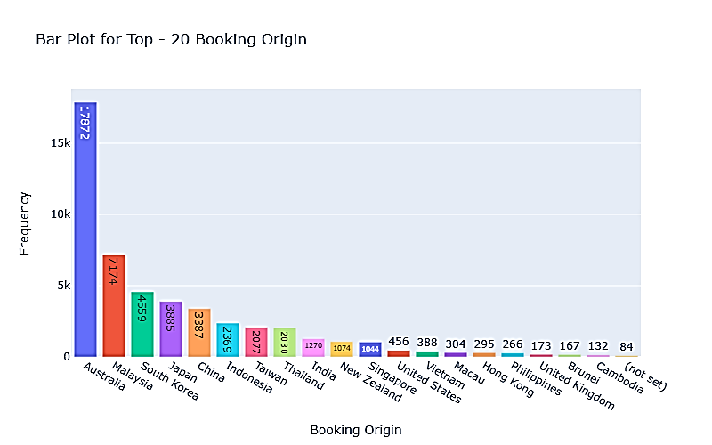
Forage British Airways Data Science Job Sim Task 2 - Predicting customer buying behaviour
Analysis: -

Slide 7
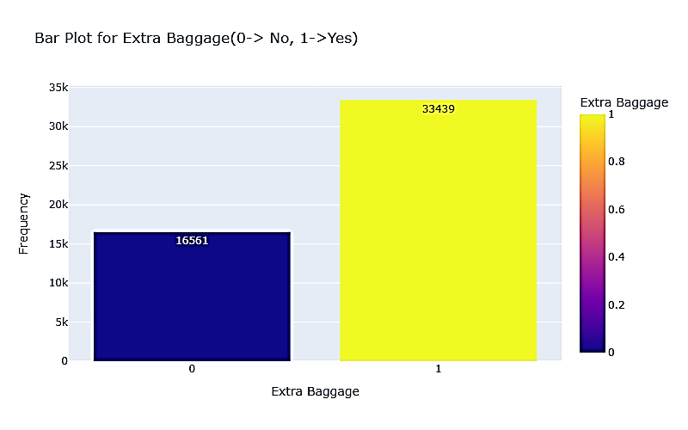
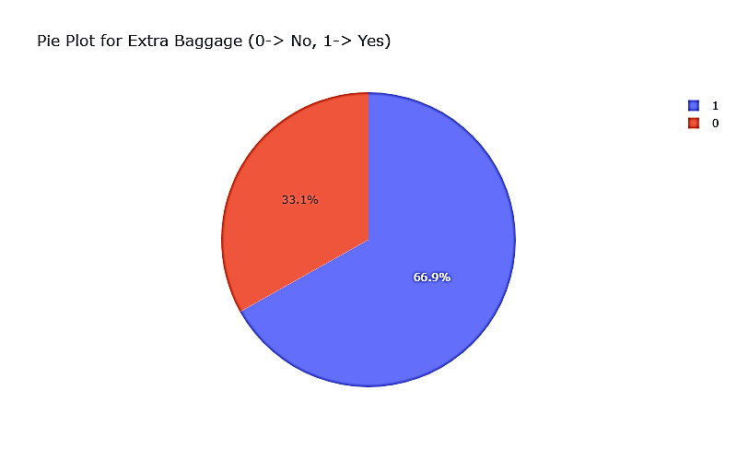
Forage British Airways Data Science Job Sim Task 2 - Predicting customer buying behaviour
Analysis: -

Slide 8
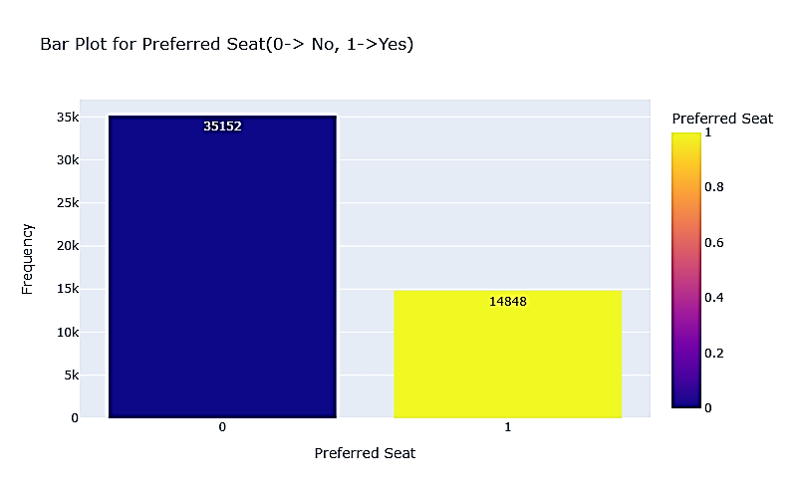
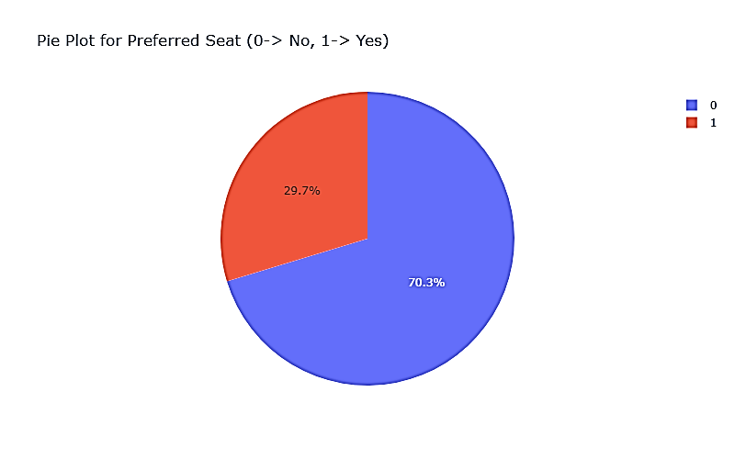
Forage British Airways Data Science Job Sim Task 2 - Predicting customer buying behaviour
Analysis: -

Slide 9
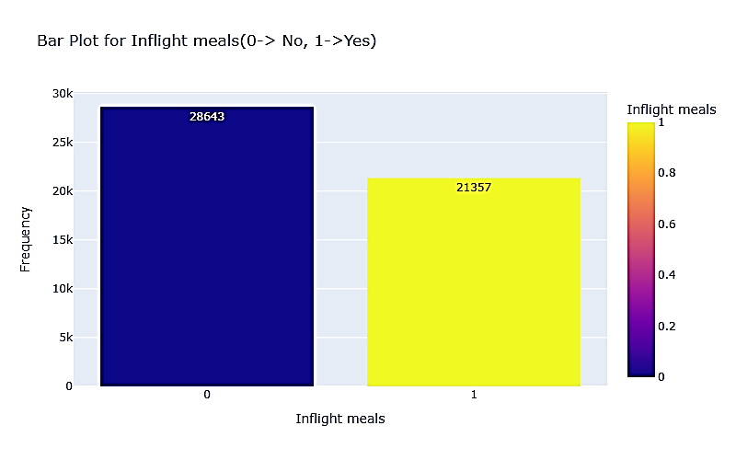
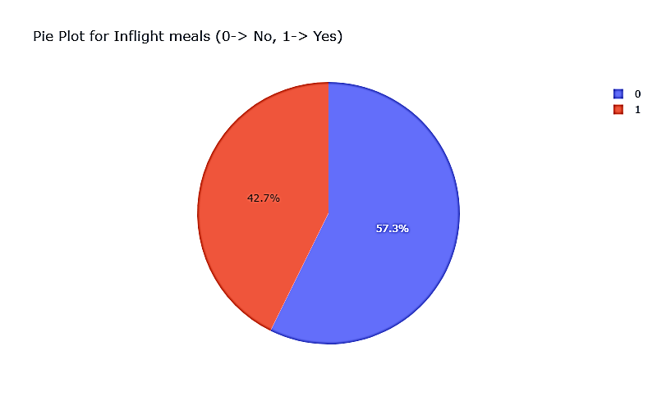
Forage British Airways Data Science Job Sim Task 2 - Predicting customer buying behaviour
Analysis: -

Slide 10
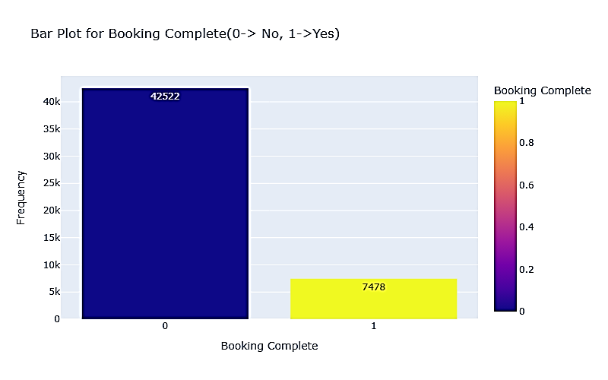
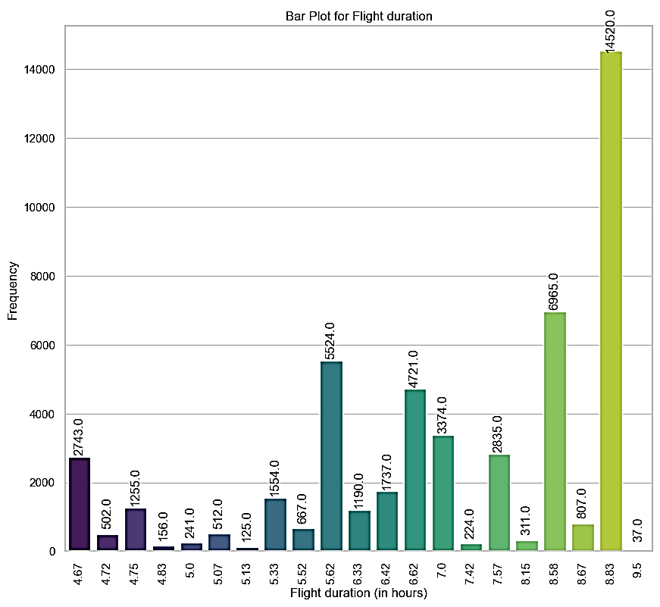
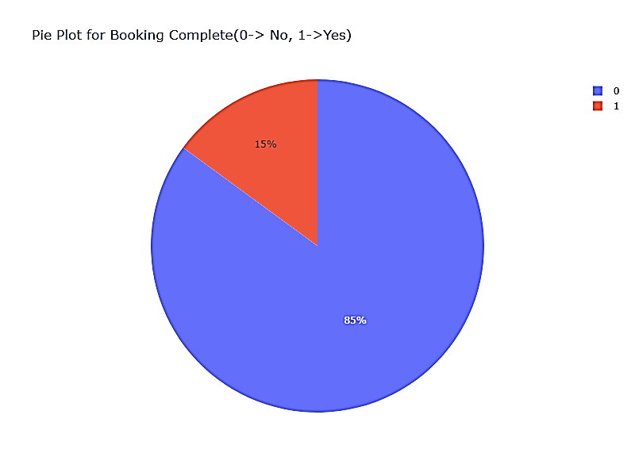
Forage British Airways Data Science Job Sim Task 2 - Predicting customer buying behaviour
Analysis: -

Slide 11
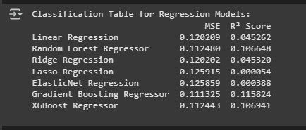
Forage British Airways Data Science Job Sim Task 2 - Predicting customer buying behaviour
Classification table: -

Slide 12
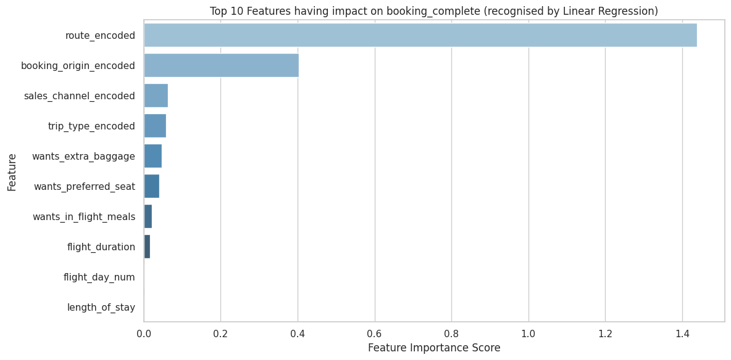
Forage British Airways Data Science Job Sim Task 2 - Predicting customer buying behaviour
Predictions: -

Slide 13
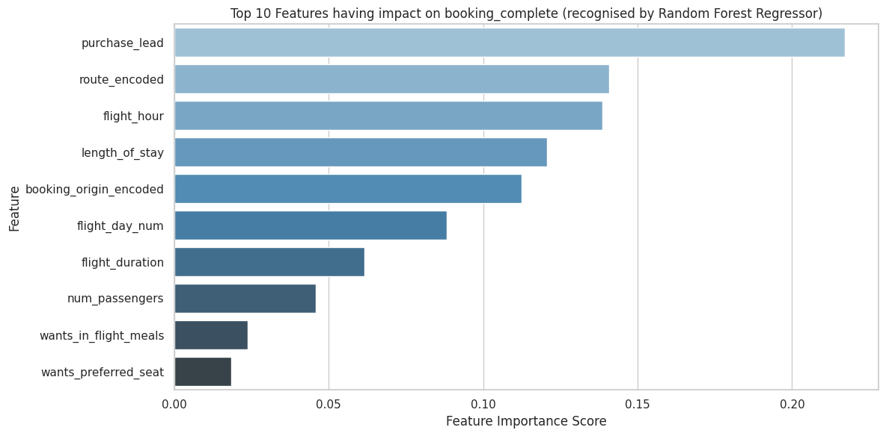
Forage British Airways Data Science Job Sim Task 2 - Predicting customer buying behaviour
Predictions: -

Slide 14
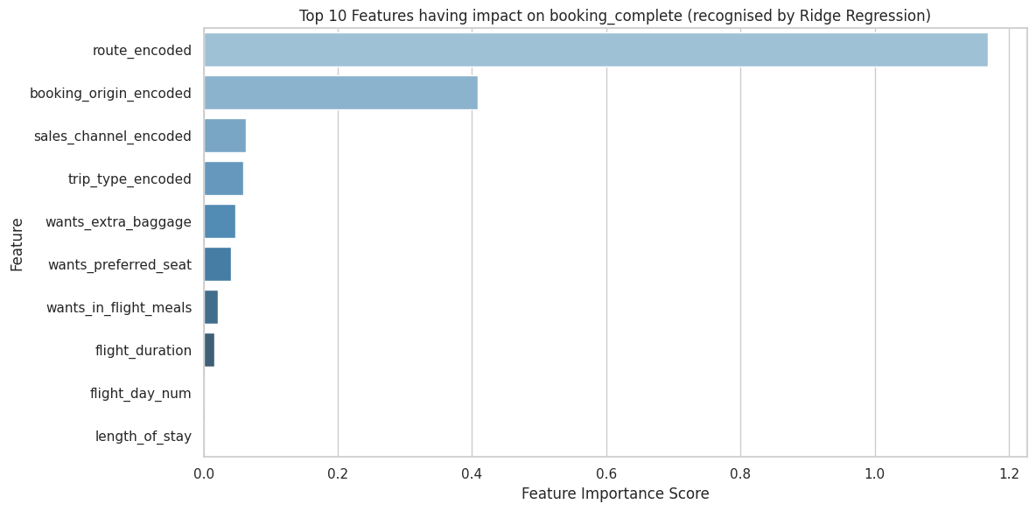
Forage British Airways Data Science Job Sim Task 2 - Predicting customer buying behaviour
Predictions: -

Slide 15
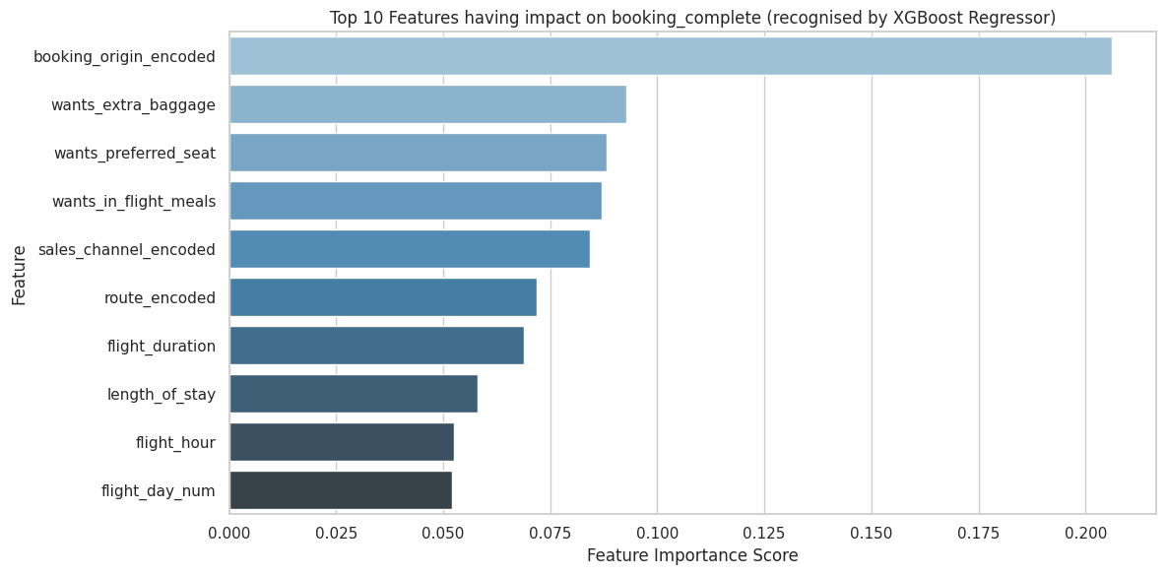
Forage British Airways Data Science Job Sim Task 2 - Predicting customer buying behaviour
Predictions: -

Slide 16
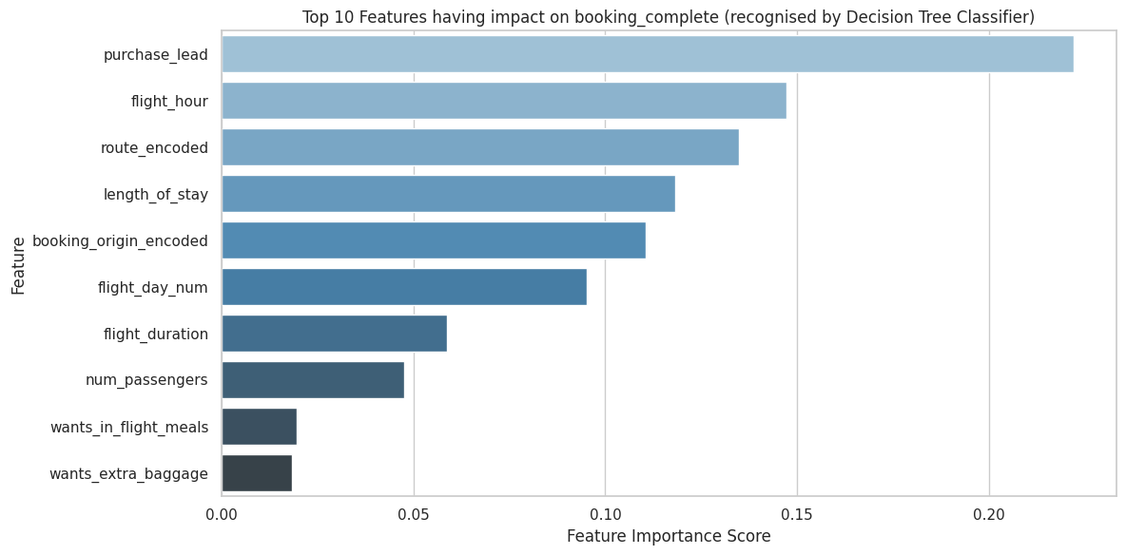
Forage British Airways Data Science Job Sim Task 2 - Predicting customer buying behaviour
Predictions: -

Slide 17
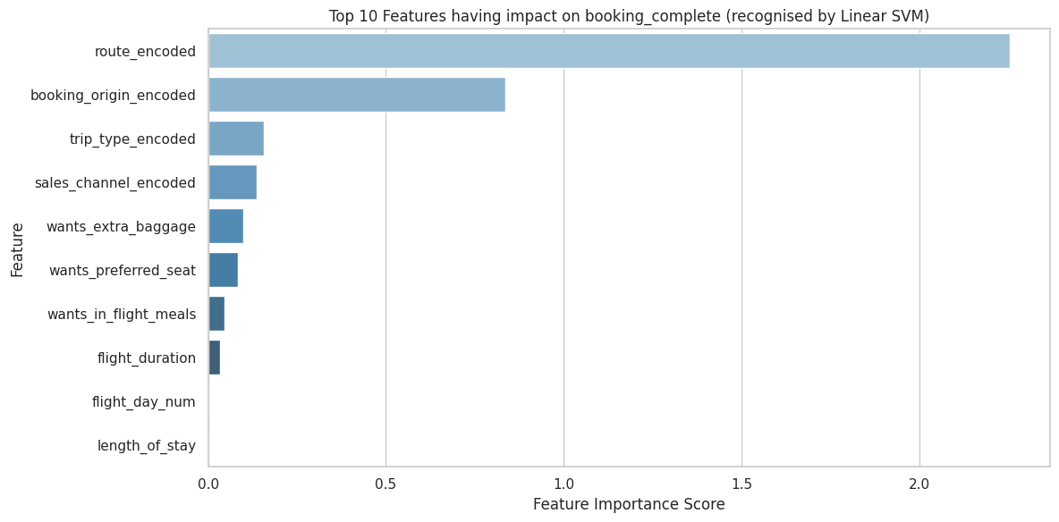
Forage British Airways Data Science Job Sim Task 2 - Predicting customer buying behaviour
Predictions: -

Slide 18
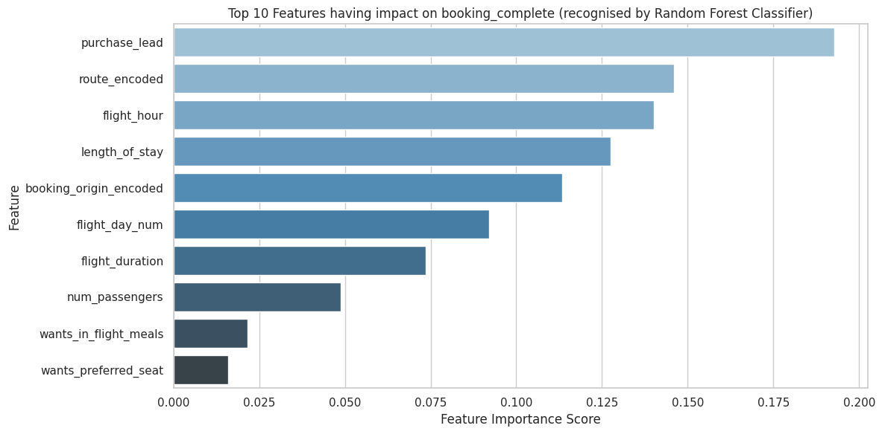
Forage British Airways Data Science Job Sim Task 2 - Predicting customer buying behaviour
Predictions: -

Slide 19
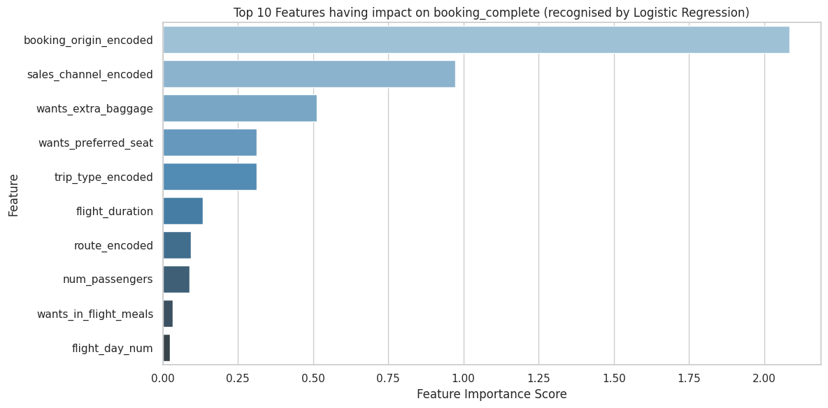
Forage British Airways Data Science Job Sim Task 2 - Predicting customer buying behaviour
Predictions: -

Slide 20
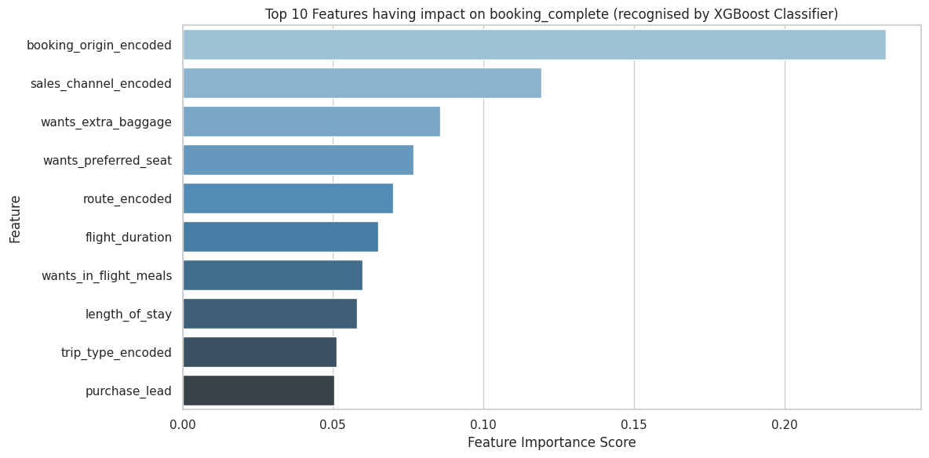
Forage British Airways Data Science Job Sim Task 2 - Predicting customer buying behaviour
Predictions: -

Slide 21
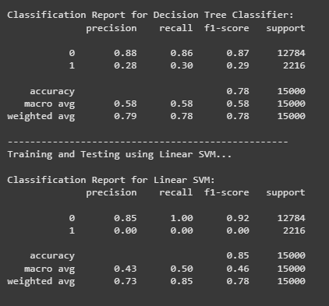
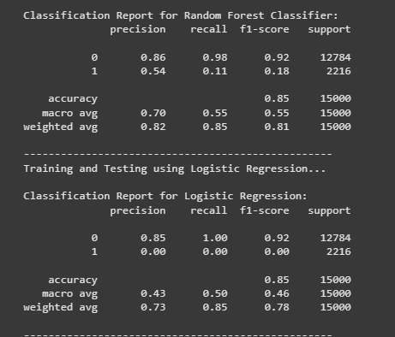
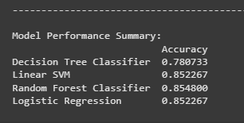
Forage British Airways Data Science Job Sim Task 2 - Predicting customer buying behaviour
Classification table: -

